Slide 1
School of Engineering
EG5066 Energy Technologies: Current Issues and Future Directions
Nuclear Energy
Jeff Gomes
October 2013
jefferson.gomes@abdn.ac.uk

Slide 2
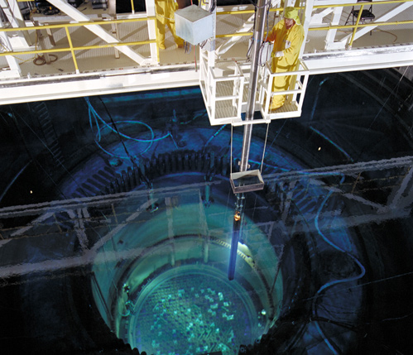
Outline
Energy Consumption
Economics of Nuclear Energy
Basics of a Power Plant
Heat From Fission
Current Commercial Nuclear Reactor Designs
Nuclear Fuel Cycle
Future Reactor Designs
jefferson.gomes@abdn.ac.uk

Slide 3
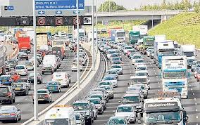
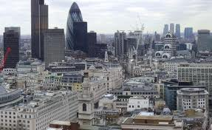
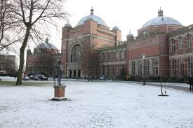

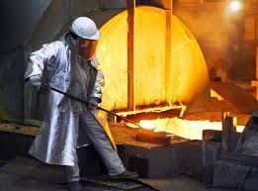

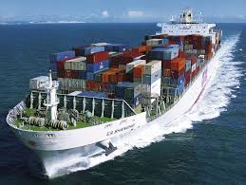
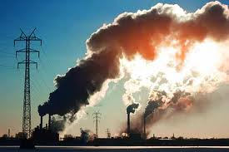
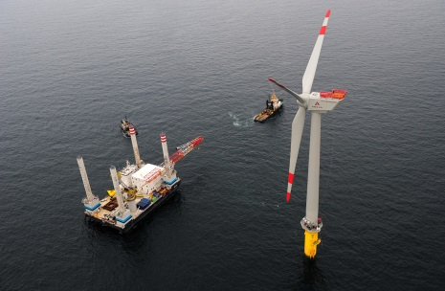
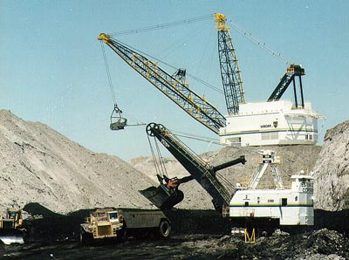
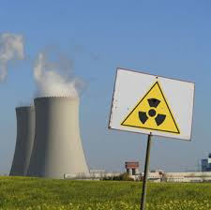
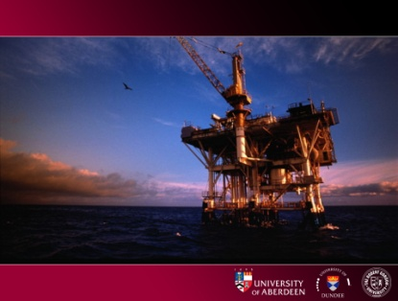
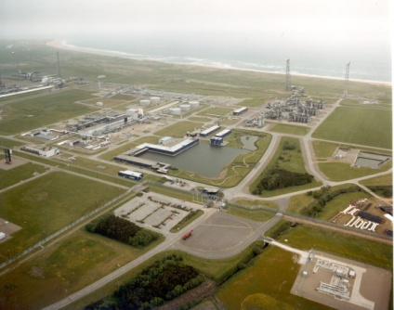
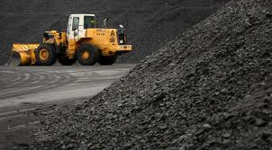
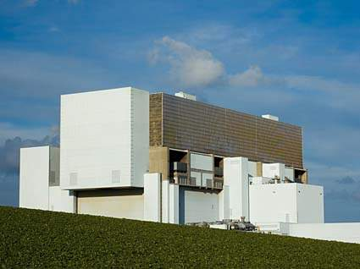
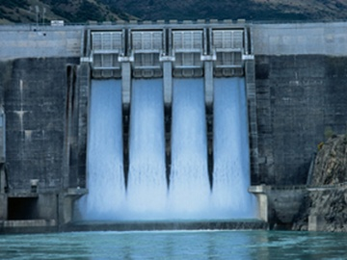
Energy:
Production & Demand
jefferson.gomes@abdn.ac.uk

Slide 4
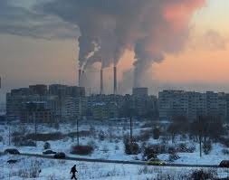
Overview of the Energy Industries
We use energy to provide:
Electricity
Heat
Transport
jefferson.gomes@abdn.ac.uk

Slide 5
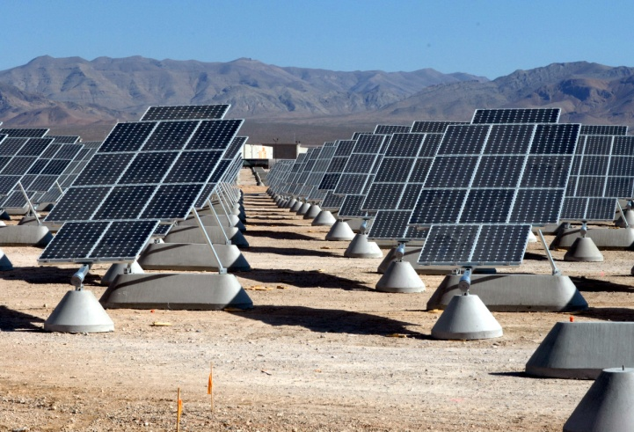
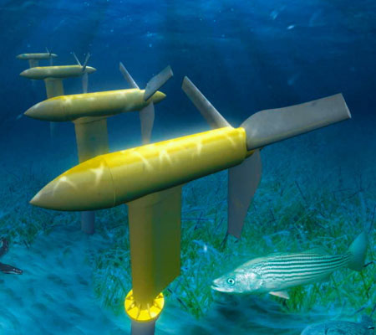
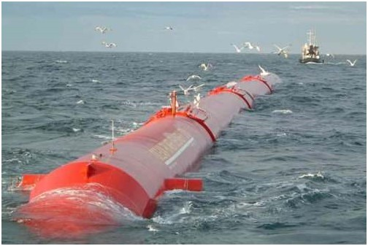
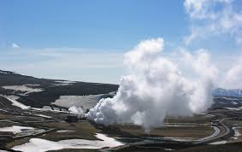
Overview of the Energy Industries
From:
Fossil fuels:
Oil;
Gas;
Coal;
Nuclear;
Hydroelectricity;
Wind;
Solar;
Maritime (wave, tide etc);
Geothermal;
Etc.
jefferson.gomes@abdn.ac.uk

Slide 6
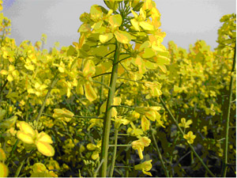
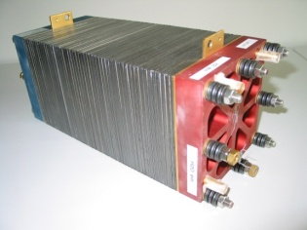
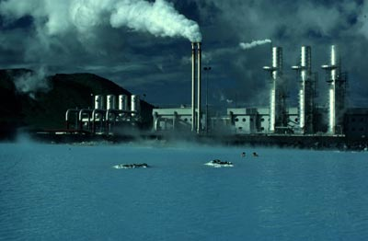
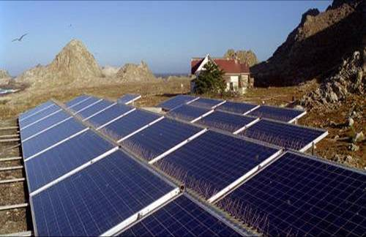
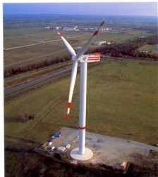
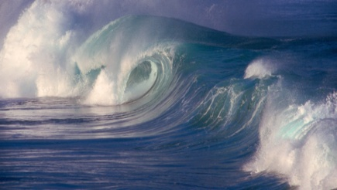
Overview of the Energy Industries
Rising energy demand;
Need to stabilise atmospheric CO₂ at 550ppm;
Aging fleet of coal & nuclear plant;
Concerns about storage of nuclear waste;
Declining oil & gas reserves 30- 50 years;
Only 70 years of uranium left;
Reduce reliance on hydrocarbons.
Policy drivers:
Low Carbon Society;
Security of Supply;
Fuel Poverty;
jefferson.gomes@abdn.ac.uk

Slide 7
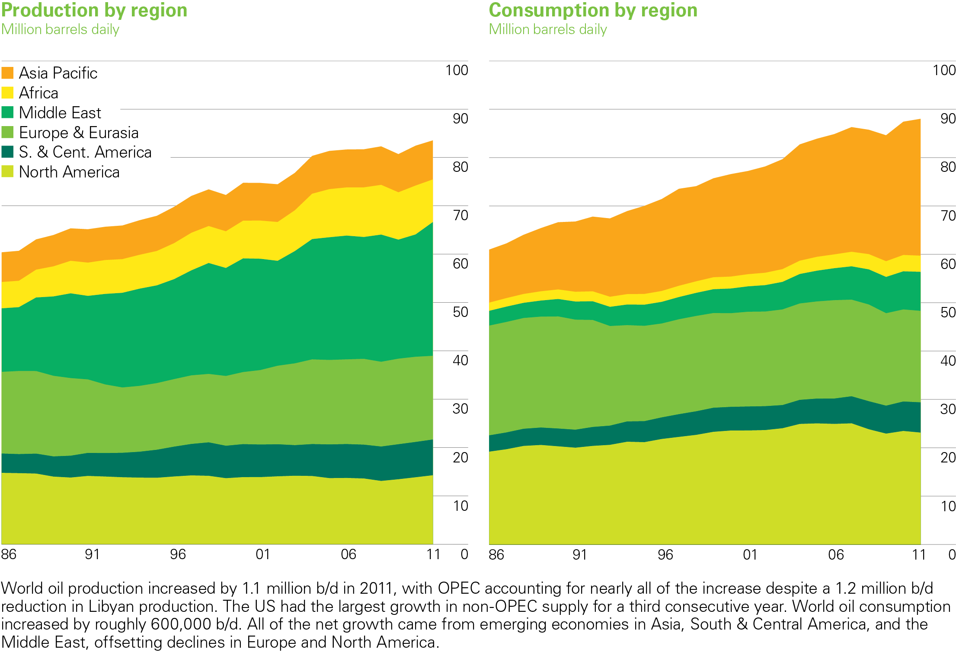
Growth Trends (1985-2010):
Oil Production/Consumption
Source: BP Statistical Review of World Energy (2012)
jefferson.gomes@abdn.ac.uk

Slide 8
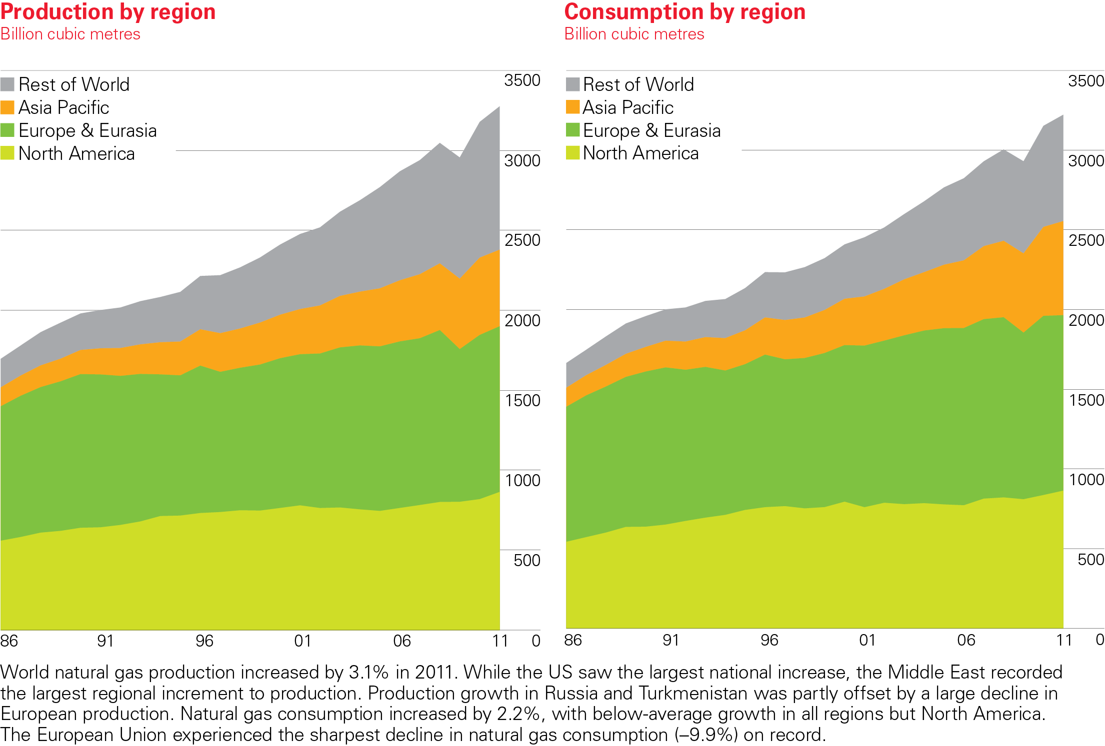
Growth Trends (1985-2010):
Natural Gas Production/Consumption
Source: BP Statistical Review of World Energy (2012)
jefferson.gomes@abdn.ac.uk

Slide 9
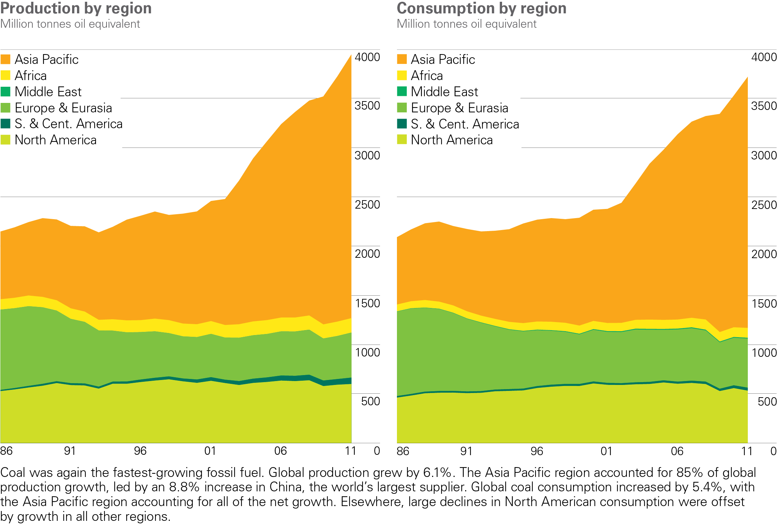
Growth Trends (1985-2010):
Coal Production/Consumption
BP Statistical Review of World Energy 2012
© BP 2012
jefferson.gomes@abdn.ac.uk

Slide 10
Growth Trends (1985-2010):
 | Production 2010 | Historical Growth | Growth(%)
Oil | 86M mbo/day | 1M mbo/year | 1.2
Coal | 3.6B Toe | 160M toe/year | 4.4
Gas | 3150B m³ | 60B m³/year | 1.9
toe: Tonnes oil equivalent
mbo: million barrel of oil
1 toe = 11.63 MWh = 41.87 GJ = 39.7M BTU
1 toe = 7.4 barrel of oil equivalent (boe)
1 barrel of oil = 159 litres
jefferson.gomes@abdn.ac.uk

Slide 11
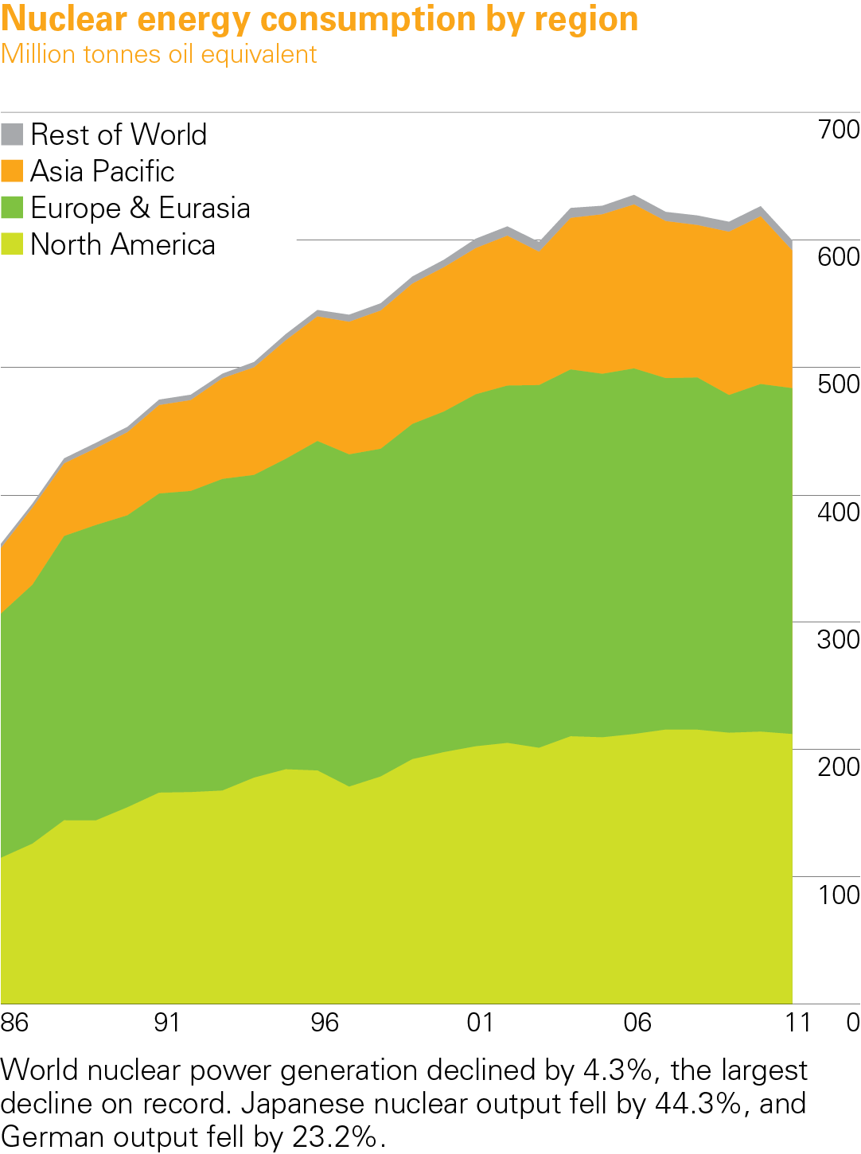
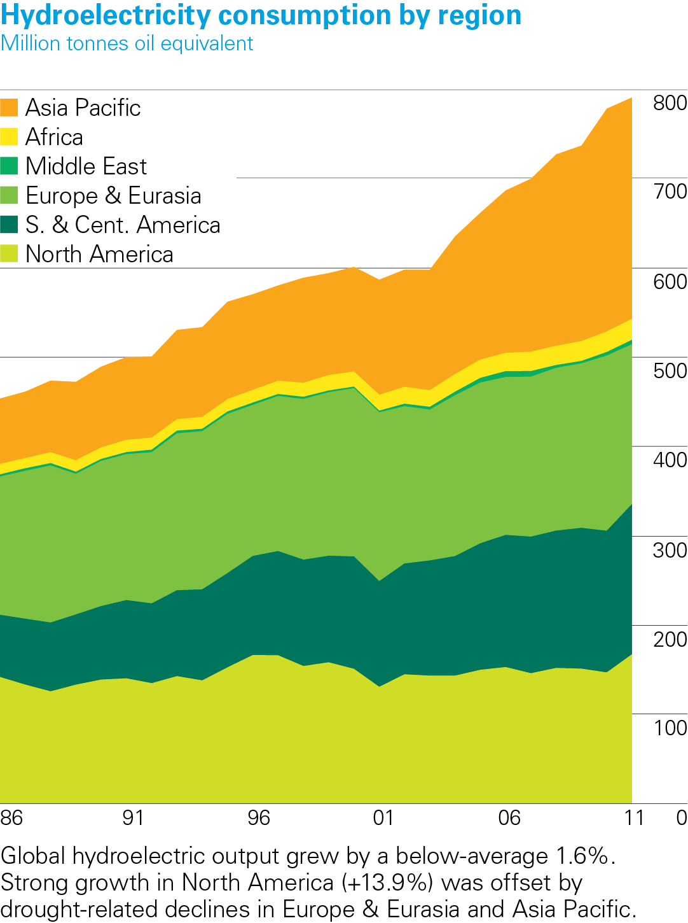
Growth Trends (1985-2010):
Source: BP Statistical Review of World Energy (2012)
jefferson.gomes@abdn.ac.uk

Slide 12
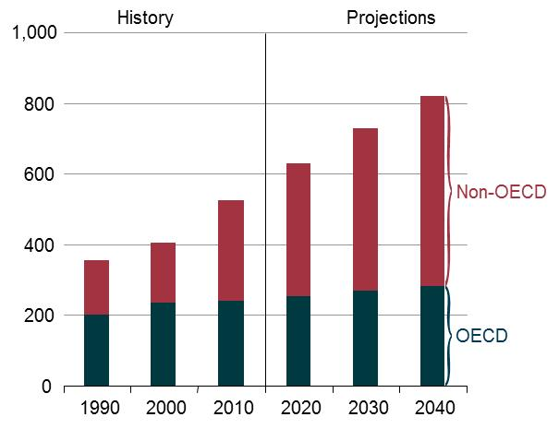
World Energy Consumption (10¹⁵ BTU)
Source: DoE/EIA-0484
jefferson.gomes@abdn.ac.uk

Slide 13
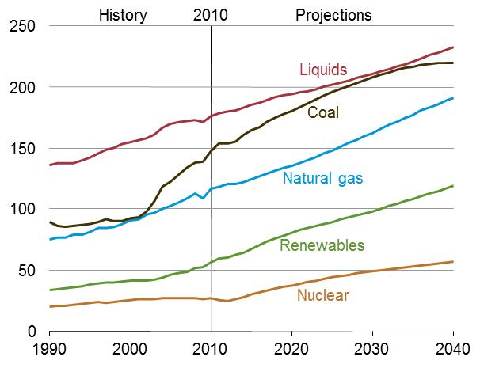
World Energy Consumption (fuel type, 10¹⁵ BTU)
Source: DoE/EIA-0484
Petroleum liquids fuels: crude oil and lease condensate, natural gas plant liquids, bitumen, extra-heavy oil, and refinery gains;
Other liquids fuels: gas-to-liquids, coal-to-liquids, kerogen and biofuels.
jefferson.gomes@abdn.ac.uk

Slide 14
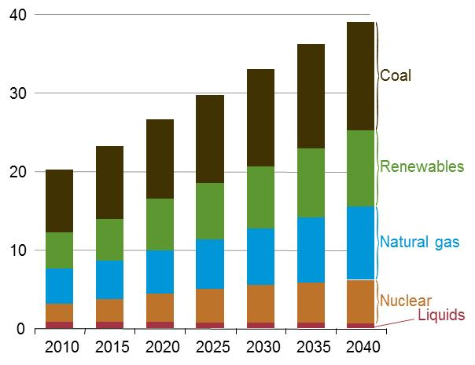
World Net Electricity Generation (fuel type, 10¹² kWh)
Variation (2010-40):
Liquids | -1.0 %
Nuclear | 2.5%
Natural Gas | 2.5%
Renewables | 2.8%
Coal | 1.8%
WORLD | 2.2%
Source: DoE/EIA-0484
jefferson.gomes@abdn.ac.uk

Slide 15
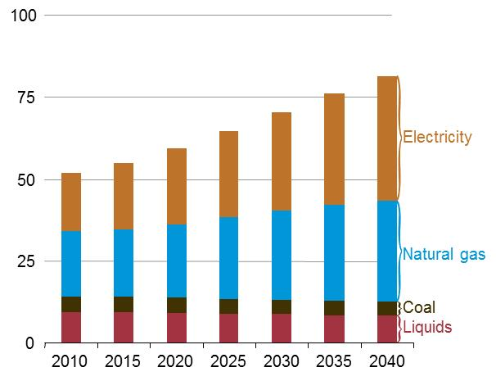
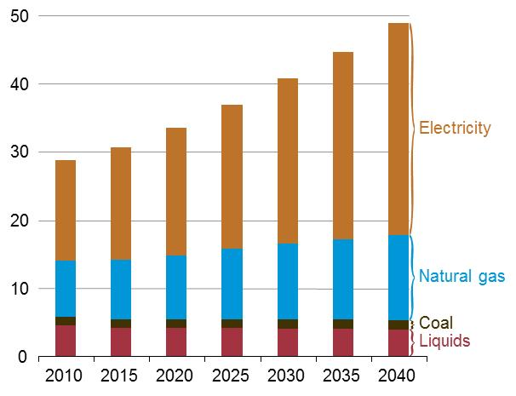
World Residential/Commercial Consumption (10¹⁵ BTU)
Residential
Commercial
Source: DoE/EIA-0484
jefferson.gomes@abdn.ac.uk

Slide 16
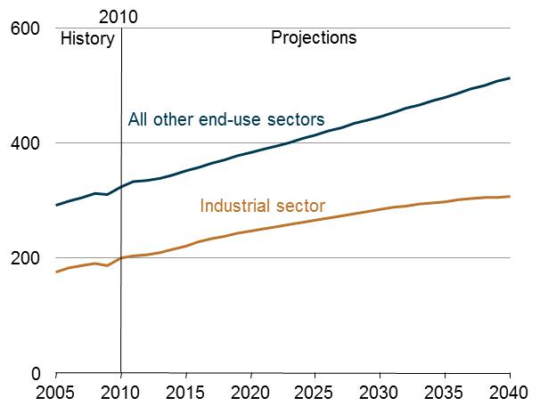
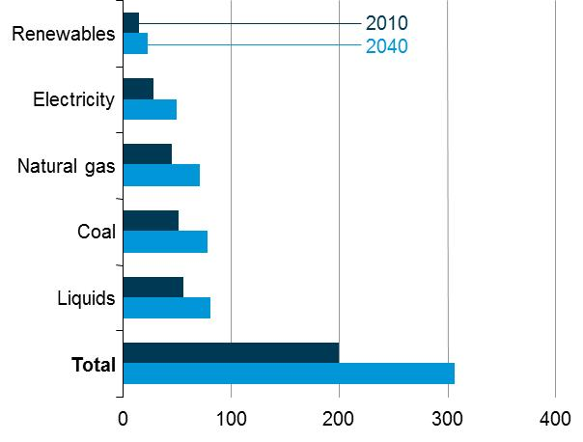
World Industrial Sector Consumption (10¹⁵ BTU)
Source: DoE/EIA-0484
jefferson.gomes@abdn.ac.uk

Slide 17
Energy Consumption: Transport Sector (10¹⁵ BTU)
Region | 2010 | 2015 | 2020 | 2030 | 2040 | Aver. Annual % change
OECD | 57.9 | 56.0 | 55.9 | 54.5 | 55.5 | -0.1
Americas | 32.7 | 32.5 | 32.5 | 31.7 | 32.9 | 0.0
Europe | 18 | 16.3 | 16.2 | 15.7 | 15.7 | -0.5
Asia | 7.1 | 7.2 | 7.1 | 7.0 | 7 | -0.1
Non-OECD | 43.1 | 50.3 | 56.4 | 68.3 | 83.9 | 2.2
Europe and Euroasia | 6.7 | 8.0 | 8.5 | 9.5 | 10.6 | 1.5
Asia | 19.9 | 23.5 | 28.0 | 37.0 | 49.2 | 3.1
Middle-East | 6 | 7.4 | 8.1 | 8.6 | 9.5 | 1.5
Africa | 3.8 | 4.0 | 4.1 | 4.5 | 4.8 | 0.8
Central and South America | 6.6 | 7.3 | 7.7 | 8.8 | 9.8 | 1.3
TOTAL | 101.0 | 106.2 | 112.2 | 122.8 | 139.5 | 1.1
Energy used to move people and goods by road, rail, air, water and pipeline.
Source: DoE/EIA-0484
jefferson.gomes@abdn.ac.uk

Slide 18
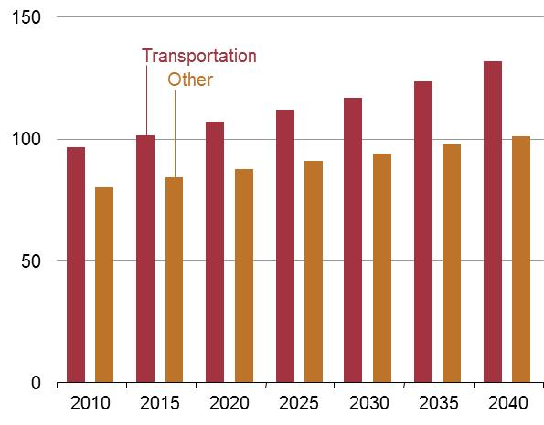
World liquid consumption (10¹⁵ BTU)
Petroleum and other liquid fuels are the main component of energy sector energy;
Transport accounts for 63% of total growth in energy consumption over 2010-40;
Transport Sector (2010-40): +36x10¹⁵ BTU;
Industry Sector (2010-40): +25x10¹⁵ BTU;
Source: DoE/EIA-0484
jefferson.gomes@abdn.ac.uk

Slide 19
10 Largest Power Plants of the World (2011)
Rank | Plant | Country | Capacity (MW_{el}) | Aver. Annual Elect. Gen. (TWh) | Plant Type
1 | 3-Gorges Dam | China | 22500 | 98.1 | Hydro
2 | Itaipu Dam | Brazil/Paraguay | 14000 | 98.2 | Hydro
3 | Guri Dam | Venezuela | 10235 | 53.41 | Hydro
4 | Tucurui Dam | Brazil | 8370 | 21.4 | Hydro
5 | Kashiwaazaki-Kariwa NPP | Japan | 8212 | 24.63 | Nuclear
6 | Grand Coulee Dam | USA | 6809 | 21 | Hydro
7 | Longtan Dam | China | 6426 | 18.7 | Hydro
8 | Bruce NPP | Canada | 6272 | 36.25 | Nuclear
9 | Uljin NPP | South Korea | 6157 | 44.81 | Nuclear
10 | Yeonggwang NPP | South Korea | 6139 | 48.16 | Nuclear
Wikipedia
jefferson.gomes@abdn.ac.uk

Slide 20
Largest Power Plants by Energy Source (2011)
Rank | Plant | Country | Capacity (MW_{el}) | Plant Type
1 | 3-Gorges Dam | China | 22500 | Hydro
2 | Kashiwaazaki-Kariwa NPP | Japan | 8212 | Nuclear
3 | Taichung Power Plant | Taiwan | 5780 | Coal
4 | Shoaiba Power Plant | Saudi Arabia | 5600 | Fuel Oil
5 | Surgut-2 Power Plant | Russia | 5597 | Natural Gas
6 | Eesti Power Plant | Estonia | 1615 | Oil Shale
7 | Shatura Power Plant | Russia | 1500 | Peat
8 | Alta Wind Energy Center | USA | 1020 | Wind (onshore)
9 | Tilbury B Power Station | UK | 750 | Biofuel
10 | Hellisheioi Power Station | Iceland | 303 | Geothermal
11 | Sihwa Lake Tidal Power Station | South Korea | 254 | Tidal
12 | Agua Calient Solar Project | USA | 251 | Solar
13 | Agucadora Wave Farm | Portugal | 2 | Marine (wave)
Wikipedia
jefferson.gomes@abdn.ac.uk

Slide 21
Energy Mix in UK
Oil
Gasoline or Diesel
Transport
4%
(with others)
Gas
Heat
(Homes & Business)
37%
Coal
34%
Renewables
5%
Electricity
Nuclear
Power Services
(Homes & Business)
20%
Zero/Low CO₂
High CO₂
jefferson.gomes@abdn.ac.uk

Slide 22
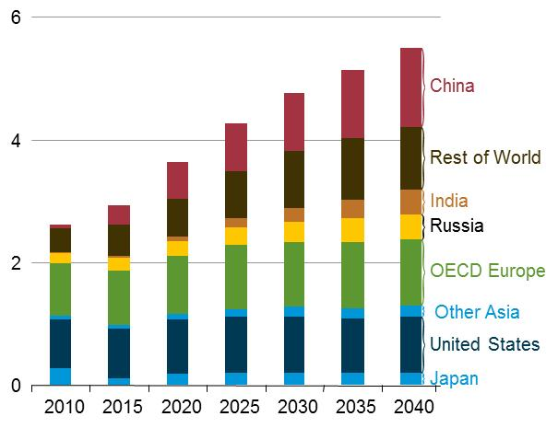
Nuclear Energy Consumption in Perspective
World electricity generation
(10¹² kWh)
World net electricity generation from nuclear
(10¹² kWh)
Source: DoE/EIA-0484
jefferson.gomes@abdn.ac.uk

Slide 23
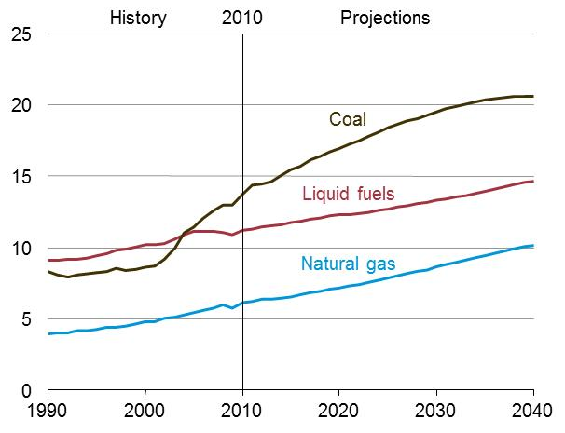
World Energy-related CO₂ Emissions (in billion metric tons)
Source: DoE/EIA-0484
1 cubic ton =40 cubic feet = 1.133 cubic meters
Increase of coal power stations → Increase coal consumption → more GHC (Greenhouse gases);
Growth in consumption of liquid fuels and natural/shale gas over the next 30 years;
Solar, wind, biomass (renewables) will benefit from intensive R&D and will continue to grow, but;
Solar and wind: unlikely to produce more than 25% of world demand of electricity by 2050.
jefferson.gomes@abdn.ac.uk

Slide 24
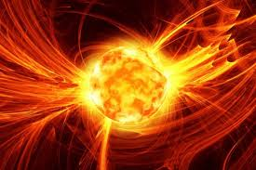
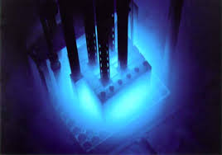
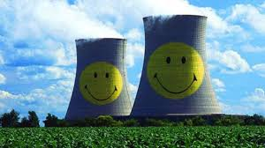
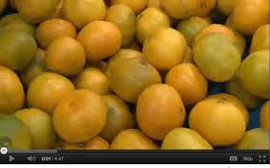
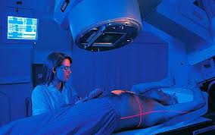
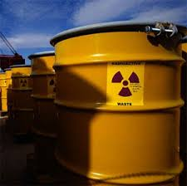
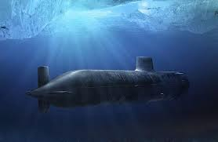
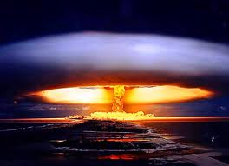
Nuclear Energy:
Fundamental Physics
jefferson.gomes@abdn.ac.uk

Slide 25
Why Nuclear ??
To address CLIMATE CHANGE we must:
improve efficiency and;
reduce use of fossil fuel-based energy source.
GHG emissions should be mitigated by the development of new cost-effective technologies:
Carbon Capture Storage and Transportation (CCST);
Nuclear →Management of nuclear waste storage;
Low-carbon energy sources (wind, solar, maritime etc);
Integrated Gasification Combined Cycle (IGCC):
Converting carbon-based fuels into syngas (gas-synthesis - mainly H2, CO);
Combined steam (e.g., Rankine) and gas (e.g., Brayton) cycles using advanced turbines with high thermal efficiency;
Energy security: some countries do not have fossil-fuel resources to sustain their economies.
jefferson.gomes@abdn.ac.uk

Slide 26
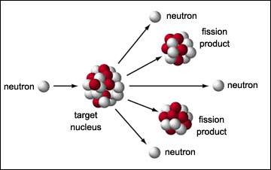




How Nuclear Works? Chain Reactions!
When a relatively large fissile atomic nucleus (e.g., U²³⁵) absorbs a neutron $\left(\overline{n}\right)$;
It splits into 2 or more lighter nuclei releasing fission products:
Kinetic energy;
Gamma radiation and ;
Free neutrons $\left(ν\overline{n}\right)$ that
Will continue the reaction, i.e., a chain reaction (also called criticality event or excursion).
$${1\overline{n}+ U}^{235}→ U^{236}→\left\{\begin{aligned}{Ba}^{141} \\ {Kr}^{92}\end{aligned}+Energy+ν \overline{n}\right.$$
jefferson.gomes@abdn.ac.uk

Slide 27

How Power Plants Work? Heat Sources!

Slide 28

How Power Plants Work? Heat Sources!
Schematics of a Nuclear Power Plant (NPP)
jefferson.gomes@abdn.ac.uk

Slide 29

How Power Plants Work? Heat Sources!
Schematics of a Coal-Fired Power Station
jefferson.gomes@abdn.ac.uk

Slide 30

How Power Plants Work? Heat Sources!
Natural Gas Power Plant
Combined Thermodynamic
Gas- and Steam-Turbines Cycles
jefferson.gomes@abdn.ac.uk

Slide 31

How Power Plants Work? Heat Sources!
Geothermal Power Plant
jefferson.gomes@abdn.ac.uk

Slide 32

How Power Plants Work? Momentum Sources!
jefferson.gomes@abdn.ac.uk

Slide 33

How Power Plants Work? Momentum Sources!
jefferson.gomes@abdn.ac.uk

Slide 34

How Power Plants Work? Momentum Sources!
jefferson.gomes@abdn.ac.uk

Slide 35


How Power Plants Work? And Solar?
Heat Source: thermal radiation to boil water or;
Photovoltaic (solar cells): direct conversion of the electromagnetic radiation from the Sun to electricity.
jefferson.gomes@abdn.ac.uk

Slide 36
How Power Plants Work?
The vast majority of power plants work based on elements of the following workflow:
Generate heat;
Boil water;
Produced steam is used to turn a (set of) turbine(s);
Turbines are linked with generator to;
Produce electricity.
We saw that:
Fossil fuels and nuclear: 1-5;
Hydro and wind: based on momentum transfer + 4-5;
Geothermal: undergrounded heated water + 2-5;
Solar: Either (a) solar radiation + 2-5 or photovoltaic cells + 5.
jefferson.gomes@abdn.ac.uk

Slide 37

How Power Plants Work?
Energy Source (coal, oil, NG, nuclear, etc) is ‘burnt’ generating heat in the;
Boiler. Heat is transferred into the water-steam cycle (3-4-9-3);
Steam (at high temperature and pressure) produced by the water vaporisation is driven towards a;
Steam turbine that promotes an isentropic expansion and produces work;
The work is transferred to a generator responsible to produce;
Electricity that is linked to the power grid;
After the expansion (in the turbine), steam (low temperature and pressure) is driven into the condenser (9), where it is transformed in water and returns to the Boiler (2);
System 7-8-9 comprises condenser and cooling waste water.
jefferson.gomes@abdn.ac.uk

Slide 38




Nuclear Power Plants (NPP)
jefferson.gomes@abdn.ac.uk

Slide 39


Nuclear Power Plants: Containment Building
Structure around the reactor core designed to protect from outside intrusion and, it is the last protection in case of accidents;
Typically a metre-thick concrete and steel building.
jefferson.gomes@abdn.ac.uk

Slide 40


Nuclear Power Plants: Steam Generator
Heat from the reactor is extracted through a coolant fluid (water, steam, CO₂, Helium etc);
The coolant fluid is then used vaporise water from the external cycle (→ high pressure and temperature steam).
The resulting steam is driven towards the turbines.
jefferson.gomes@abdn.ac.uk

Slide 41



Nuclear Power Plants: Turbine & Generator

Slide 42


Nuclear Power Plants: Elements of the Reactor
Nuclear Fuel
Graphite Core
Control Rods
Cooling Fluid Flows
jefferson.gomes@abdn.ac.uk

Slide 43





Nuclear Power Plants: Elements of the Reactor
Fuel pellets
Nuclear core
Fuel assembly
Fuel rods
TRISO particles
Uranium coated with graphite): ~ 1mm
jefferson.gomes@abdn.ac.uk

Slide 44
Current Commercial Nuclear Reactor Designs
Pressurized Water Reactor (PWR)
Boiling Water Reactor (BWR)
Advanced Gas-Cooled Reactor (AGR)
Pressurized Heavy Water Reactor (CANDU)
Light Water Graphite Reactor (RBMK)
Fast Neutron Reactor (FBR)
jefferson.gomes@abdn.ac.uk

Slide 45
Current Commercial Nuclear Reactor Designs
Reactor | Fuel | Moderator | Coolant
PWR | Enriched Uranium | Light water | Light water
BWR | Enriched Uranium | Light water | Light water/steam
Magnox | Natural Uranium | Graphite | CO₂ gas
AGR | Enriched Uranium | Graphite | CO₂ gas
CANDU | Natural Uranium | Heavy water | Heavy water
RBMK | Enriched Uranium | Graphite | Light water/steam
LMFBR | Highly Enriched Uranium | None | Liquid sodium
jefferson.gomes@abdn.ac.uk

Slide 46


Pressurized Water Reactor (PWR)
Main nuclear reactor type;
Primary coolant fluid is superheated water under high pressure;
Light water is used as both coolant & moderator
Diablo Canyon Power Plant
PWR Reactor Vessel heads
jefferson.gomes@abdn.ac.uk

Slide 47


Pressurised Water Reactor (PWR)
Schematics of a Naval PWR
Reactor is contained in a steel pressure vessel;
Pressure vessel, boilers and connecting pipe-work form a sealed primary pressurised circuit, which is contained within a steel-lined pre-stressed concrete containment building.
Schematics of a PWR

Slide 48

Boiling Water Reactor (BWR)
2nd most common reactor;
Ordinary water used as moderator & coolant;
Operates at low pressure which allows water to boil.
jefferson.gomes@abdn.ac.uk

Slide 49


Boiling Water Reactor (BWR)
Chin Shan NPP (Taiwan): two 604MWe BWRs.
No separate secondary steam cycle;
Water from reactor converted to steam & used to directly drive the generator turbine.
jefferson.gomes@abdn.ac.uk

Slide 50


Pressurized Heavy Water Reactors (PHWR-Candu)
Canadian invented pressurized heavy water reactor late 1950s & 1960s
CANada Deuterium Uranium: deuterium-oxide (i.e., heavy water) moderator and Uranium
CANDU Bruce Nuclear Reactor
Second largest plant in the world.
jefferson.gomes@abdn.ac.uk

Slide 51


Pressurized Heavy Water Reactors (PHWR-Candu)
jefferson.gomes@abdn.ac.uk

Slide 52

Magnox Reactors
The first commercial nuclear stations in the UK;
Named after the magnesium alloy used to make the fuel can containing the uranium fuel
Use natural uranium metal as the fuel
Graphite moderator
Pressurised CO₂ as the coolant
jefferson.gomes@abdn.ac.uk

Slide 53


Advanced Gas-cooled Reactor (AGR)
2nd generation of British gas-cooled reactors – developed from Magnox
Uses graphite as the neutron moderator and CO₂ as coolant
Configured with 2 reactors in single building
Windscale Advanced Gas-cooled reactor (WAGR) : built in the 1960s and decommissioned in 2011. It produced approximately 3257500 MWh during operation life .
jefferson.gomes@abdn.ac.uk

Slide 54
Advanced Gas-cooled Reactor (AGR)
Use enriched uranium clad stainless steel cans;
Also have a graphite moderator and use pressurised CO₂ as the coolant;
AGRs are able to operate at a higher temperature than the Magnox reactor;
Coolant conveys heat from the reactor to the boilers which, in turn, heats water in an isolated steam circuit which is then used to turn the turbines.

Slide 55




High-Power Channel Reactor (RBMK)
Chernobyl
Russian design;
Class of graphite-moderated nuclear power reactor;
Type involved in Chernobyl accident;
Uses light water for cooling and graphite for moderation;
Uses natural uranium for fuel.
Ignalina Nuclear Power Plant, Lithuania

Slide 56



Fast Neutron Reactor
Fission chain reaction sustained by fast neutrons;
Needs no neutron moderator;
Needs fuel rich in fissile material;
All current fast reactors are liquid metal cooled (lead or sodium);
Fuel – enriched uranium or plutonium.
Shevchenko BN350 nuclear-heated desalination plant
Superphenix power plant, France
Dounreay

Slide 57
Current Commercial Nuclear Reactor Designs
Reactor Type | Main Countries | Number | GWe | Fuel | Coolant (Temp in ºC) | Moderator
Pressurised water reactor (PWR) | US, France, Japan, Russia, China | 265 | 251.6 | Enriched UO₂ | Water (300) | Water
Boiling Water Reactor (BWR) | US, Japan, Sweden | 94 | 86.4 | Enriched UO₂ | Water (300) | Water
Pressurised heavy water reactor “Candu” | Canada | 44 | 24.3 | Natural UO₂ | Heavy water (300) | Heavy Water
Gas cooled reactor | UK, Russia | 18 | 10.8 | Natural U Enriched UO₂ | He, CO₂ (600) | Graphite
Light water graphite reactor (RBMK) | Russia | 12 | 12.3 | Enriched UO₂ | Water (300) | Graphite
Liquid Metal-Cooled (LMFBR) | Japan, France, Russia, China | 4 | 1 | PuO₂ & UO₂ | Liquid Sodium,Lead and Lead-Bismuth (600) | None
(2008)
jefferson.gomes@abdn.ac.uk

Slide 58

Current Commercial Nuclear Reactor Designs
Sources: World Nuclear Association (2010)

Slide 59

Energy Consumption
Nuclear Reactors across the World
Source: IAEA
jefferson.gomes@abdn.ac.uk

Slide 60
Energy Consumption
Environmental Impacts of Energy Matrix
FUEL PHASE | Coal | Petroleum | Natural Gas | Nuclear | Hydro | Solar Terrestrial Photovoltaic | Solar Power Tower | Wind | Fusion | Geothermal
Extraction Refining Transportation On-Site Thermal Air Water Aesthetic Wastes Sprecial Problems Major Accident | Mining Accidents Lung Damage Refuse Piles Collision High Efficiency Particulates­ SO₂, NO_{x} Water Treat­ ment Chemi­ cals Large Plant Transmission Lines Ash, Slag - - Mining | Drilling-Spills (off-shore) Water Pollu­ tion Spills High Efficiency SO₂, NO_{x} Water Treat­ ment Chemi­ cals Large Plant Transmission Lines Ash - - Oil Spill | Drilling - - Pipeline Explosion High Efficiency NO_{x} Water Treat­ ment Chemi­ cals Large Plant Transmission Lines - - - - Pipeline Explosion | Mining Accidents Lung Damage Milling Tails - - Low Efficiency BWR Radia­ tion Releases Water Treat­ ment Chemi­ cals Small Plant Transmission Lines Spent Fuel Transportation Reprocessing Waste Storage - - Reactor Cooling | Construction - - - - - - - - Destroys Prior Ecosystems Small Plant Transmission Lines - - - - Dam Failure | Mining Accidents - - - - Low Efficiency Ecosystem Change - - Water Treat­ ment Chemi­ cals Poor Large Area Spent Cells Construction Accidents Fire | - - - - - - Ecosystem Change - - Water Treat­ ment Chemi­ cals Poor Large Area - - - - - - | - - - - - - - - - - - - Large Area Large Towers Noise? - - Bird, Human Injuries - - | He, H₂, Li Production - - - - - - - - Tritium in Cooling Water Small Area Irradiated Struc­ tural Material Occupational Radiation Doses Tritium Release | - - - - - - Low Efficiency H₂S Brine in Streams Poor Large Area Cool Brine - - - -
Source: MITOpenCourseWare
jefferson.gomes@abdn.ac.uk

Slide 61


Current- and Next-Generation of Nuclear Reactors
jefferson.gomes@abdn.ac.uk

Slide 62



Energy Consumption
Evolution of Nuclear Power Plants
Gen IV
Generation I
Generation II
Generation III
Generation III+
Early prototype
reactors
Commercial power
reactors
Advanced
LWRs
Near-term
deployment
Economic
Safe
Min waste
Shippingport
Dresden
Fermi
Magnox
ABWR
System 80+
AP600
EPR
Evolutionary designs with improved economics
LWR-PWR, BWR
CANDU
VVER/RBMK
Gen IV
Generation I
Generation II
Generation III
Generation III+
1950
1960
1970
1980
1990
2000
2010
2020
2030
jefferson.gomes@abdn.ac.uk

Slide 63


Selected Generation III+ Reactors
Pebble Bed Reactor
Use pebbles containing fissile materials;
These are based on TRISO particles with either UO₂+PuO₂ (i.e., MOX) or UO₂+ThO₂ core with layers of graphite for material integrity and thermal homogenisation;
No control rods;
Cooled with Helium gas (>400ºC).
jefferson.gomes@abdn.ac.uk

Slide 64



Selected Generation III+ Reactors
Advanced Boiling Water Reactor (ABWR)
More compact design → cuts construction costs and increases safety.
Additional control rod power supply improves reliability;
Equipment and components designed for ease of maintenance.

Slide 65
Energy Consumption
Selected Generation III+ Reactors
Advanced BWR -- Hitachi-GE (Japan-USA) and Toshiba (only Generation III+ reactor design already implemented in the industry): Kashiwazaki-Kariwa NPP Units 6 & 7 (first ABWRs in the world, 1996 & 1997); Hamaoka#5 (2005); Shika#2 (2006); also 2 units planned to be built in USA and another 2 in Taiwan;
Advanced CANDU Reactor (ACR-1000);
Advanced PWR: Toshiba-Westinghouse AP-1000, 6 are being constructed in China, another 12 are planned to be built in China and USA;
Advanced PWR: 4 AP-1400 are being built in South Korea and another 4 in the United Arab Emirates;
European Pressurized-water Reactor (EPR) - AREVA, France: 1 will be in operation in Finland (2014), 1 is under construction in France and 2 in China;
VVER (Russian design PWR with ~1200 MWel): 6 under construction in Russia and 4 planned to be built in Turkey.
jefferson.gomes@abdn.ac.uk

Slide 66
Energy Consumption
Nuclear Fuel Cycle
Fuel Type and Assemblies
Type of Reactor (% fraction):
PWR (66%)
BWR (22%)
Candu (6%)
RBMK (3%)
AGR (2.7%)
Type of Fuel:
UO₂
MOX (UO₂ + PuO₂)
U Metal
Thorium/Uranium
(enrichment levels)
jefferson.gomes@abdn.ac.uk

Slide 67
Energy Consumption
Generation IV (GenIV) Reactors: Goals
More efficient use of U and/or Th → long fuel cycle (refuelling 15-20 years);
Higher burn up (i.e., Actinide burning);
More economical (relative small capacity) → production of H₂ as by-product;
Production of minimal amount of waste;
Less long-lived waste;
Inheritably safe;
More proliferation resistant (misuse of nuclear elements);
Ability to burn weapons grade fuel.
jefferson.gomes@abdn.ac.uk

Slide 68
Energy Consumption
Generation IV (GenIV) Reactors
Gas Cooled Fast Reactor (GFR)
Very High Temperature Reactor (VHTR)
Supercritical Water Cooled Reactor (SCWR)
Sodium Cooled Fast Reactor (SFR)
Lead Cooled Fast Reactor (LFR)
Molten Salt Reactor (MSR)
Reactors planned to be deployed in 2030s.
jefferson.gomes@abdn.ac.uk

Slide 69

Generation IV (GenIV) Reactors
Gas Cooled Fast Reactor (GFR)
Or High-Temperature Reactors (HTRs);
Fast-neutron spectrum;
Helium-cooled reactor (Brayton thermal cycle);
The high output temperature of the helium coolant (485-850ºC and 7MPa) makes it possible to:
deliver electricity (288 MWe);
produce hydrogen;
process heat with high efficiency.
Closed fuel cycle;
Robust refractory fuel.
jefferson.gomes@abdn.ac.uk

Slide 70

Generation IV (GenIV) Reactors
Very High Temperature Reactor (VHTR)
Graphite-moderated (thermal spectrum)
Helium-cooled reactor
No reprocessing;
Core outlet temperatures of coolant (500-1000ºC and 9MPa);
The cycle is operated with a combined Brayton cycle (gas-turbine cycle) and a Rankine steam cycle through heat exchangers.
jefferson.gomes@abdn.ac.uk

Slide 71

Generation IV (GenIV) Reactors
Supercritical Water-Cooled Reactor (SCWR)
High-temperature and high-pressure water-cooled reactor;
Reactor is operated above the thermodynamic critical point of water (<625ºC and 25MPa);
Built upon two proven-technologies:
Light water reactors (LWRS) and;
Supercritical fossil-fired boilers;
jefferson.gomes@abdn.ac.uk

Slide 72

Generation IV (GenIV) Reactors
Supercritical Water-Cooled Reactor (SCWR)
jefferson.gomes@abdn.ac.uk

Slide 73

Generation IV (GenIV) Reactors
Molten Salt Reactor (MSR)
Produces fission power in a circulating molten salt fuel mixture:
epithermal-spectrum reactor;
full actinide recycle fuel cycle.
Brayton cycle;
Molten fluoride salts have excellent heat transfer characteristics and a very low vapor pressure, which reduce stresses on the vessel and piping.
jefferson.gomes@abdn.ac.uk

Slide 74

Generation IV (GenIV) Reactors
Sodium Cooled Fast Reactor (SFR)
Fast-spectrum (facilitates breeding) ➔ sodium does not moderate neutrons as water does!
Sodium-cooled reactor;
Closed fuel cycle (reprocessing) for efficient management of actinides and conversion of fertile uranium.;
Rankine Cycle with power output of 500-1500 MWe (~550ºC).
jefferson.gomes@abdn.ac.uk

Slide 75

Generation IV (GenIV) Reactors
Lead Cooled Fast Reactor (LFR)
Fast-spectrum lead or lead/bismuth eutectic liquid metal-cooled reactor
Closed fuel cycle (reprocessing) for efficient conversion of fertile uranium and management of actinides.;
Brayton Cycle;
Higher temperature (550-800ºC) enables the production of hydrogen by thermochemical processes.
Very long refueling interval (15 to 20 years) (proliferation resistant) ;
jefferson.gomes@abdn.ac.uk

Slide 76





Issues for Nuclear Power

Slide 77

Issues for Nuclear Power
Safety
Weapons proliferation/terrorism
Windscale , UK 1957
Three Mile Island, USA, 1979
Chernobyl, Ukraine, 1986
Fukushima-Daiichi, Japan, 2011
Wastes
Need to find long-term storage solution that satisfies concerns of public
Costs
More expensive than gas-fired power stations
Not “too cheap to meter”
Increasing in response to concerns over safety
Availability of Uranium
Is there more than 50 years supply left?
jefferson.gomes@abdn.ac.uk

Slide 78


Issues for Nuclear Power
Safety
Windscale , UK 1957 - fire at plutonium production pile releases 1000TBq of radioactive iodine
Three Mile Island, USA, 1979 – loss of coolant, partial meltdown of the fuel in the reactor core
Windscale Fire
Three Mile Island
jefferson.gomes@abdn.ac.uk

Slide 79


Issues for Nuclear Power
Safety
Chernobyl, Ukraine, 1986
Fukushima-Daiichi, Japan, 2011
Fukushima Daiichi Nuclear Disaster
Chernobyl after the disaster
jefferson.gomes@abdn.ac.uk

Slide 80



Issues for Nuclear Power
Wastes
Need to find long-term storage solution that satisfies concerns of public
Swedish KBS-3 capsule for nuclear waste
Geologic Depository at Olkiluoto Nuclear Power Plant in Finland
jefferson.gomes@abdn.ac.uk

Slide 81

Issues for Nuclear Power: Uranium Availability
Nuclear Fuel Cycle
jefferson.gomes@abdn.ac.uk

Slide 82
Issues for Nuclear Power: Uranium Availability
MATERIAL BALANCE IN THE NUCLEAR FUEL CYCLE
(based on annual operation of a 1000 MWe reactor)
Mining | 20000 tonnes of 1% uranium core
Milling | 230 tonnes of uranium oxide concentrate (~ 195 tU)
Conversion | 288 tonnes UF₆ (~ 195 tU)
Enrichment | 35 tonnes enriched UF₆ (~ 24 tU)
Fuel fabrication | 27 tonnes UO₂ (~24 tU enriched)
Reactor operation | 8.76 TWh of electricity at full output (22.3 tonnes of natural U per TWh)
Used fuel | 27 tonnes: 240 kg transuranics (e.g., Pu), 23 tU (0.8% U²³⁵), 1.1 tonnes of fission products
jefferson.gomes@abdn.ac.uk

Slide 83


Issues for Nuclear Power: Uranium Availability
Recoverable Resources of Uranium

Slide 84
Energy Consumption
Factors to Affect the Use of Nuclear Energy Technologies
Operational safety record;
Degree if nuclear weapons proliferation;
Nuclear waste disposal success;
Global warming and air pollution;
Nuclear power to produce electricity and heat more efficiently;
New technologies for medical isotopes and food irradiation;
Cost and safety policies;
Public concern.
jefferson.gomes@abdn.ac.uk

Slide 85
Energy Consumption
Summary
Multiple energy sources: fossil-fuel, uranium-plutonium-thorium, wind, solar, tides, wave etc;
Demand and production of energy mix;
Thermal and momentum energy sources;
Current nuclear reactor technologies;
GenIV reactors.
jefferson.gomes@abdn.ac.uk

Slide 86
Energy Consumption
Additional Reading
BP Statistical Review 2012: http://www.bp.com/content/dam/bp/pdf/Statistical-Review-2012/statistical_review_of_world_energy_2012.pdf
International Energy Outlook 2013 (DoE/EIA-0484): http://www.eia.gov/forecasts/ieo/pdf/0484(2013).pdf
Annual Energy review 2011 (DoE/EIA-0384): http://www.eia.gov/totalenergy/data/annual/pdf/aer.pdf
Energy for a Sustainable Future: Reports and Recommendations (2010), The Secretary-General’s Advisory Group on Energy and Climate Change (AGECC): http://www.un.org/wcm/webdav/site/climatechange/shared/Documents/AGECC%20summary%20report%5B1%5D.pdf
The Economics of the Back End of the Nuclear Fuel Cycle, NEA Report No 7061: http://www.oecd-nea.org/ndd/pubs/2013/7061-ebenfc.pdf
jefferson.gomes@abdn.ac.uk

